Slide 1
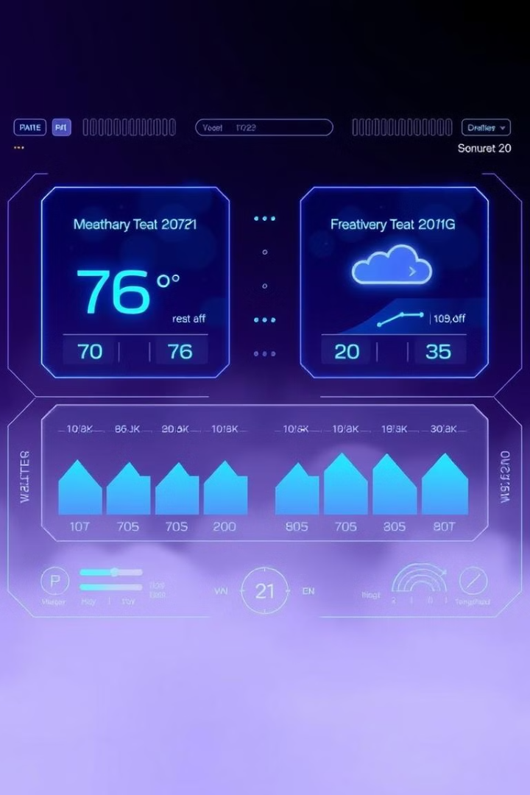
Weather Prediction System Using Dynamic Programming
Innovative approach to short-term weather forecasting.
Utilizes historical data and dynamic programming techniques.

Slide 2
Project Overview
Objective
Approach
Impact
Predict weather conditions using historical data.
Dynamic programming for efficient short-term predictions.
Accessible weather forecasting without heavy computational requirements.

Slide 3




Problem Statement
Traditional Challenges
High computational cost of numerical weather prediction models.
Accessibility Issues
Limited everyday access to complex forecasting models.
Proposed Solution
Lightweight prediction system with web-based interface.

Slide 4
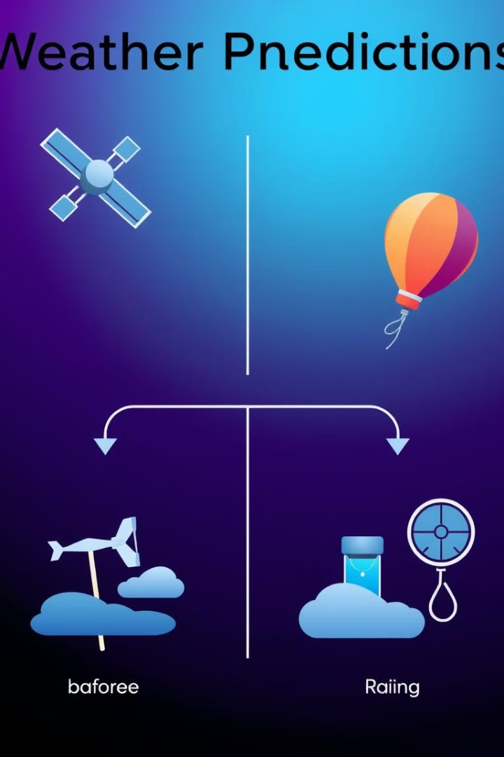
Background and Related Work
Numerical Weather Prediction Models
Complex, computationally expensive
Machine Learning-based Models
Large datasets, significant training required
Dynamic Programming Approach
Optimized prediction with reduced complexity

Slide 5
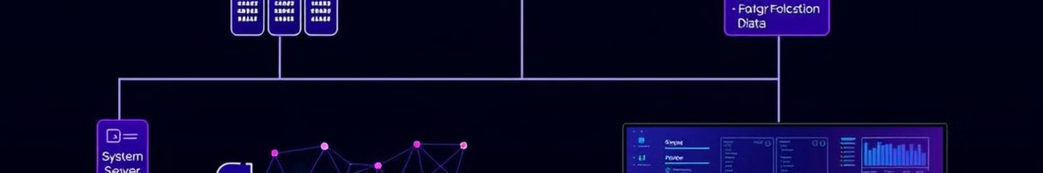
System Architecture
1
Data Collection
Historical weather data from Meteostat API.
2
Processing
Dynamic programming algorithm for temperature and precipitation forecasting.
3
Display
Web interface using HTML, CSS, JavaScript.

Slide 6

Design Process
1
Feature Evaluation
2
Design Flow
Temperature and precipitation prediction using dynamic programming.
Data collection, preprocessing, algorithm application, web display.
3
Challenges
Ensuring prediction accuracy and optimizing system performance.

Slide 7
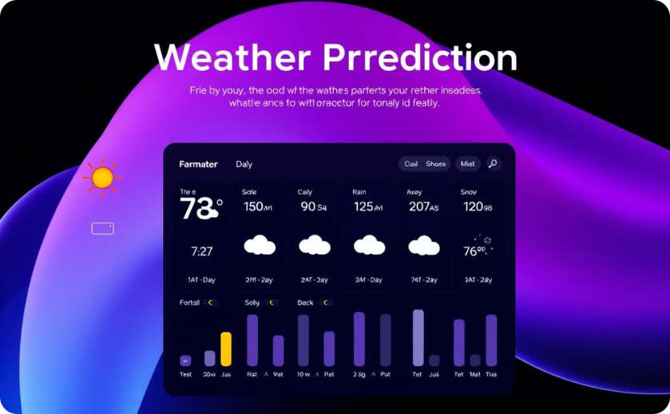
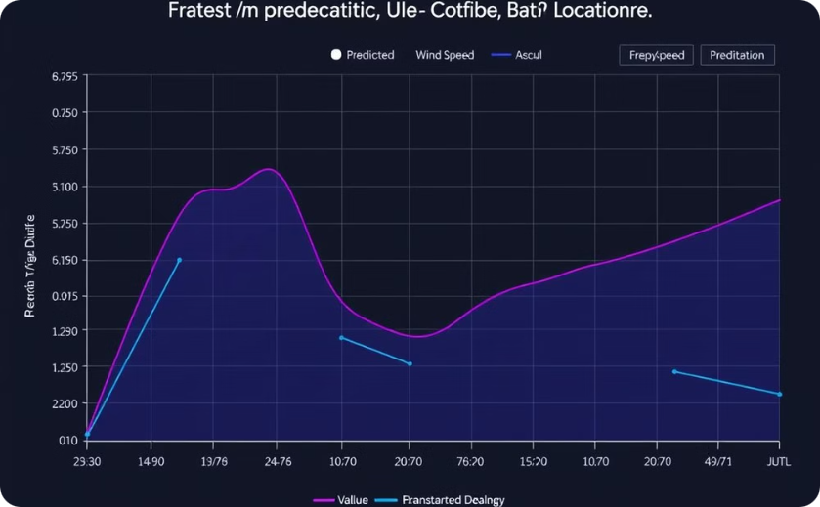
Results and Implementation
System Output
Validation
Multi-day predictions based on user input.
Predicted results compared with real-world weather data.

Slide 8




Conclusion and Future Work
Successful Implementation
Dynamic programming-based weather prediction with user-friendly interface.
Future Enhancements
Incorporate more variables and real-time data integration.
Long-term Vision
Explore machine learning models for extended predictions.

